Slide 1
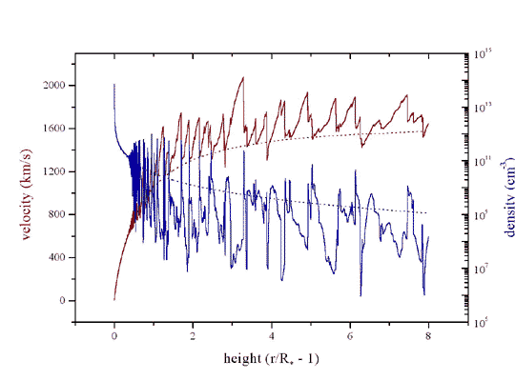
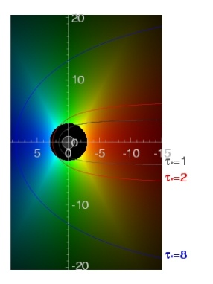
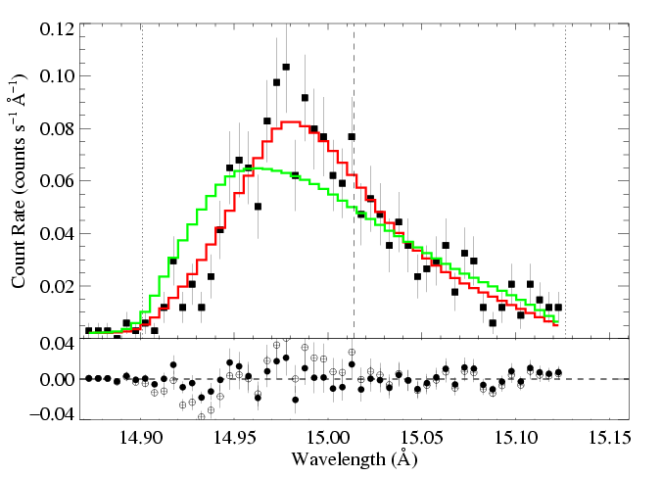
X-ray Spectral Diagnostics of Activity in O and Early-B Stars
wind shocks and mass-loss rates
David Cohen
Swarthmore College

Slide 2
Scope
X-ray emission from normal, effectively single and non-magnetic O and early-B stars
What does it tell us about high-energy process and about the winds on these stars?

Slide 3
Goal
To go from the observed X-ray spectra to a physical picture:
Kinematics and spatial distribution of the
> 1,000,000 K plasma
Column-density information that can be used to measure the mass-loss rate of these winds

Slide 4
aside
The X-rays are quite time-steady, but the underlying processes are highly dynamic – activity

Slide 5
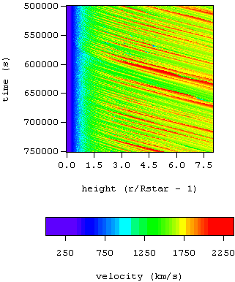
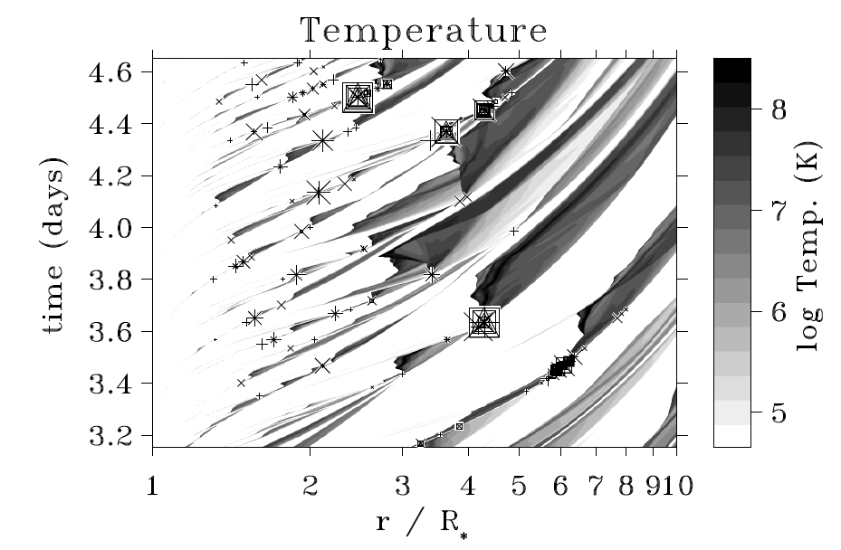
Theory & numerical simulations
Self-excited instability
Excited by turbulence imposed at the wind base
Owocki, Cooper, Cohen 1999
Feldmeier, Puls, Pauldrach 1997
Notes:
5

Slide 6
Numerous shock structures, distributed above ~1.5 R*
Notes:
6

Slide 7
V_{shock} ~ 300 km/s :
T ~ 10⁶ K
shock onset at r ~ 1.5 R_{star}
Shocked wind plasma is decelerated back down to the local CAK wind velocity
Notes:
7

Slide 8
The paradigm
Shock-heated, X-ray emitting plasma is distributed throughout the wind, above some onset radius (R_{o})
The bulk of the wind (~99%) is unshocked, cool (T < T_{eff}) and X-ray absorbing (τ*)
There are different types of specific models within this paradigm, and many open questions

Slide 9
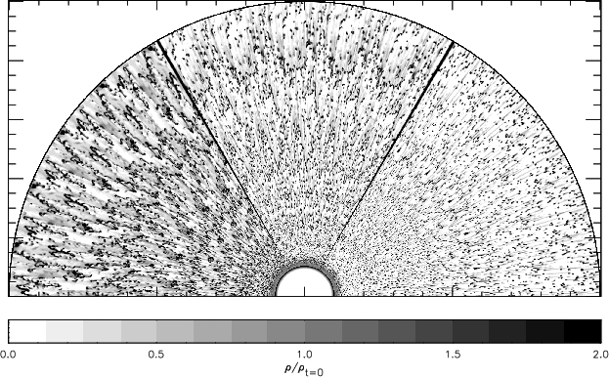
More realistic 2-D simulations: R-T like break-up; structure on quite small scales
Dessart & Owocki 2003, A&A, 406, L1
Notes:
9

Slide 10
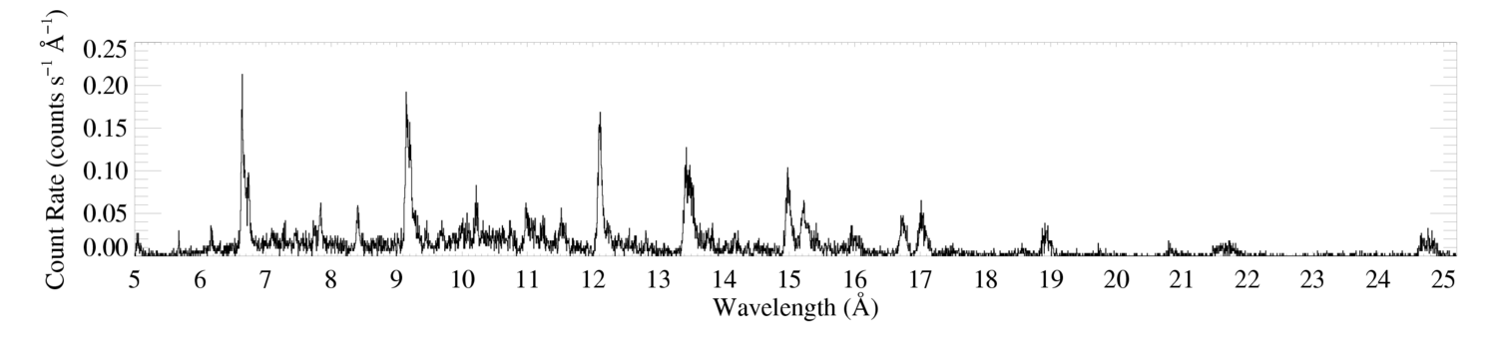
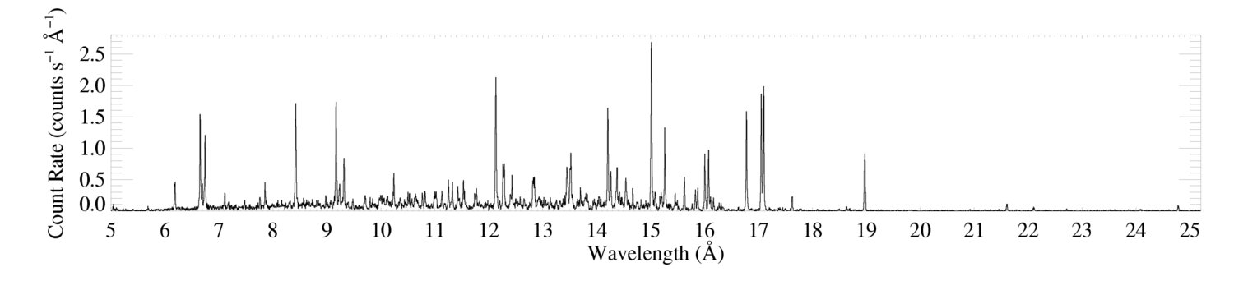
Morphology
ζ Pup (O4 If)
Capella (G5 III) – coronal source
– for comparison
Notes:
Back to the broad lines.

Slide 11
Chandra HETGS (R < 1000)
ζ Pup (O4 If)
Capella (G5 III) – coronal source
– for comparison
Notes:
Back to the broad lines.

Slide 12
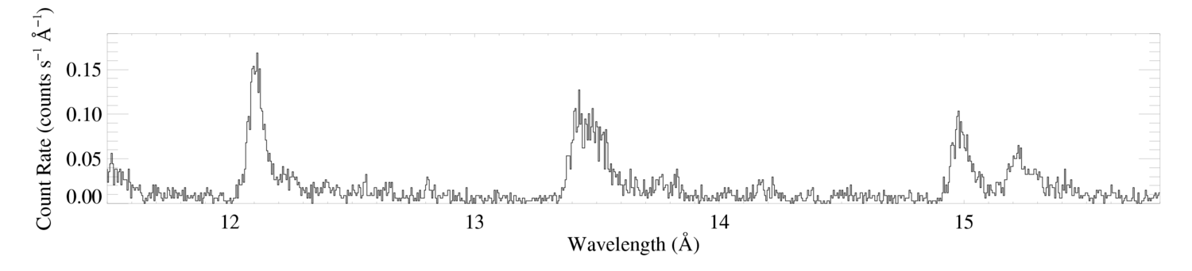
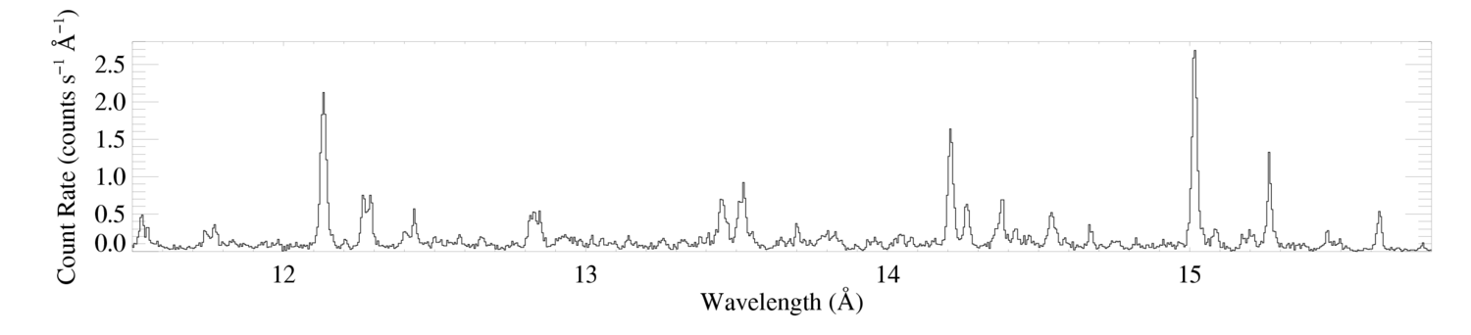
Morphology – line widths
ζ Pup (O4 If)
Ne X
Ne IX
Fe XVII
Capella (G5 III) – coronal source
– for comparison

Slide 13
Morphology – line widths
ζ Pup (O4 If)
Ne X
Ne IX
Fe XVII
~2000 km/s ~ v_{inf}
Capella (G5 III) – coronal source
– for comparison

Slide 14
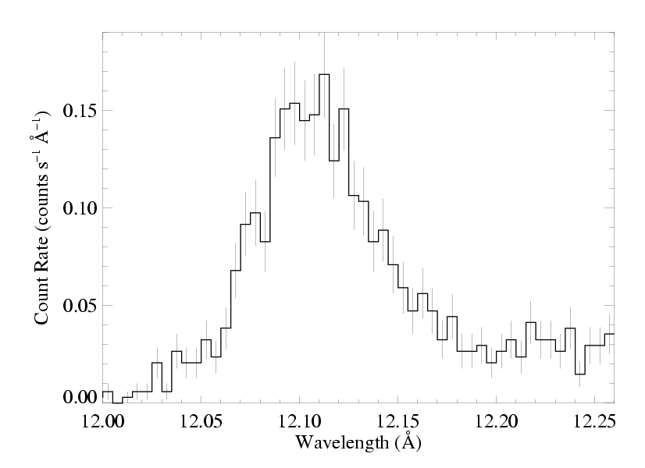
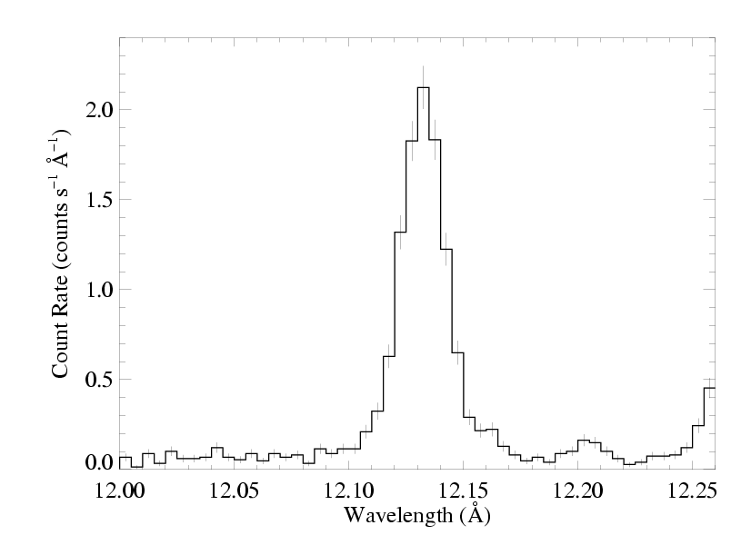
ζ Pup (O4 If)
Capella (G5 III) – unresolved

Slide 15
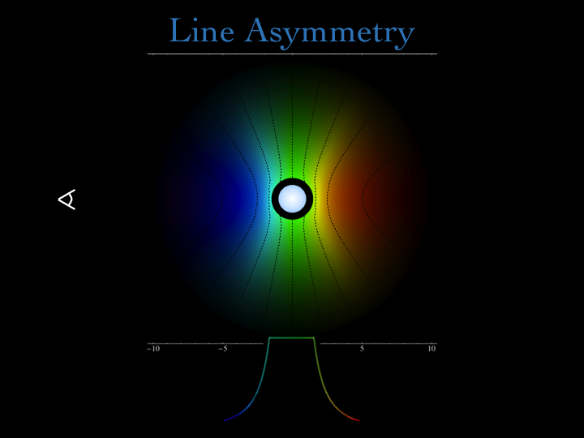

Slide 16
R_{o}
Profile shape assumes beta velocity law and onset radius, R_{o}

Slide 17
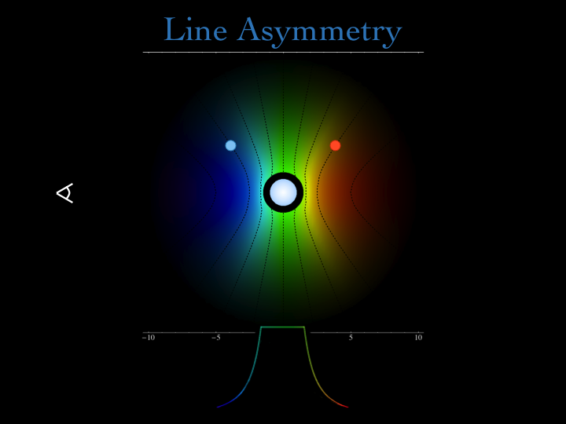

Slide 18
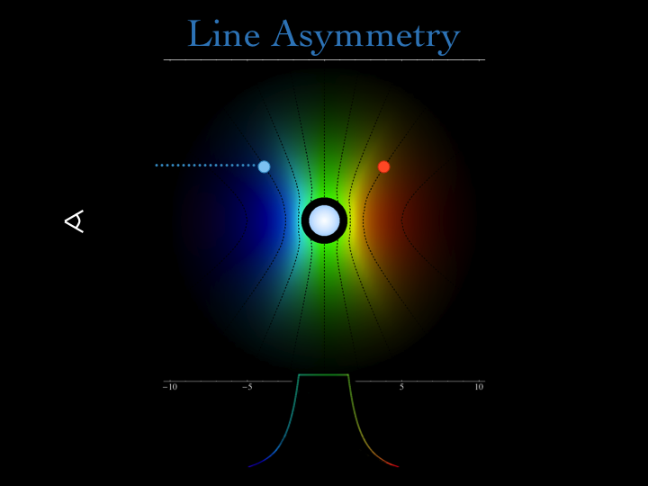

Slide 19


Slide 20


Slide 22
Universal property of the wind
z different for each point

Slide 23
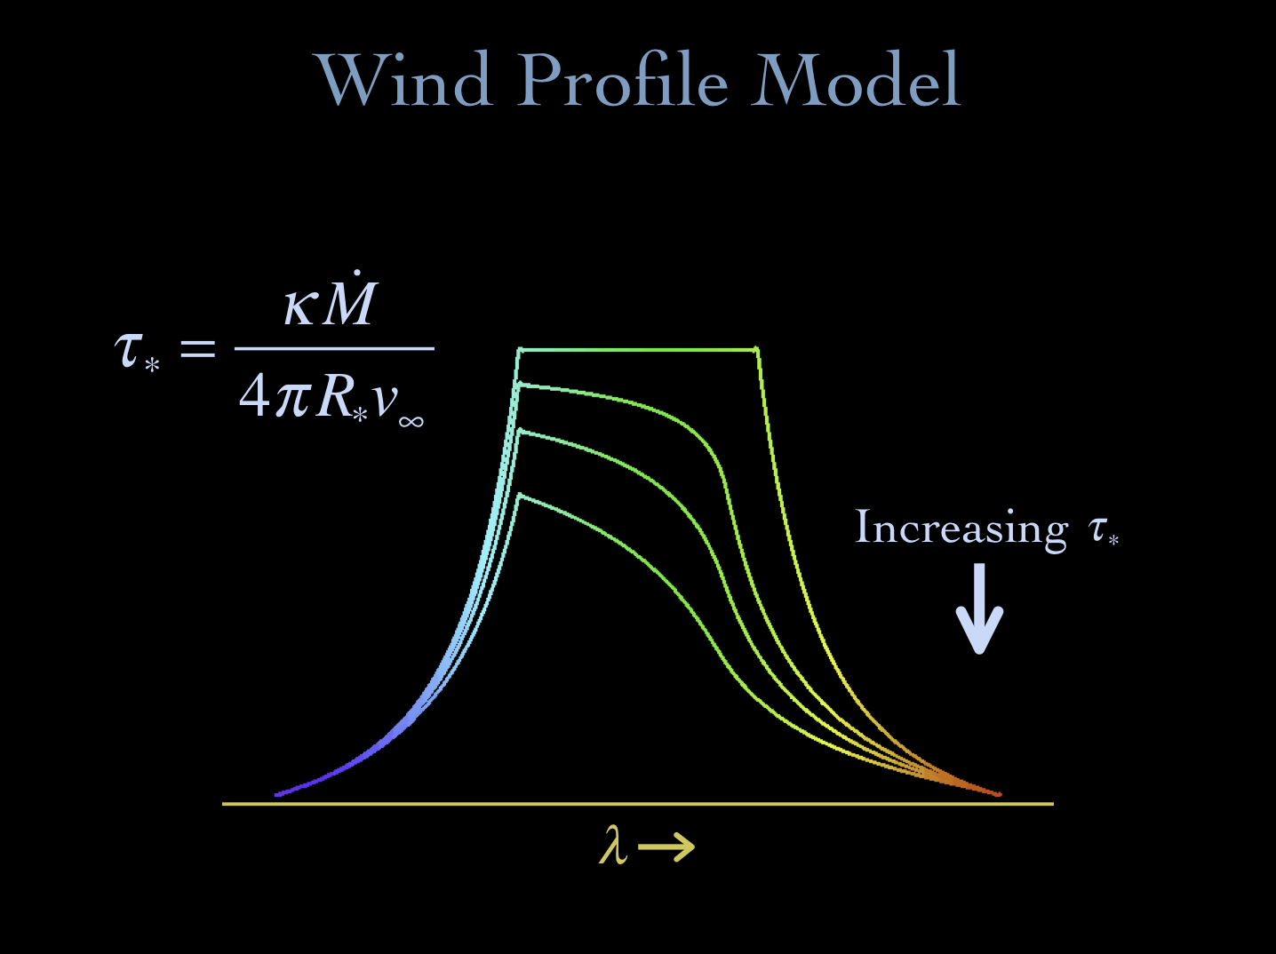
Notes:
23

Slide 24
ζ Pup (O4 If)
Capella (G5 III) – unresolved

Slide 25
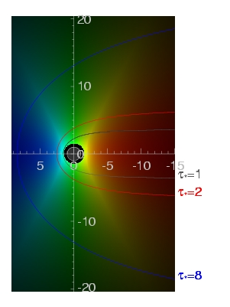
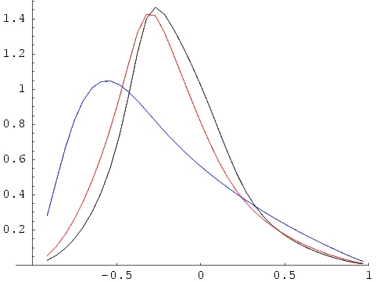
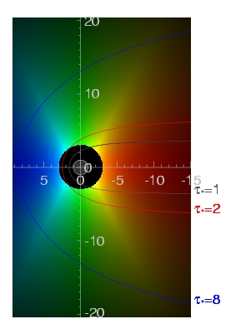
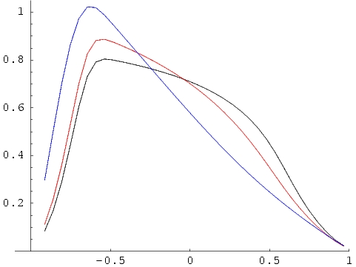
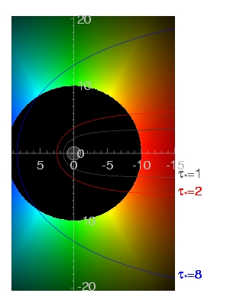
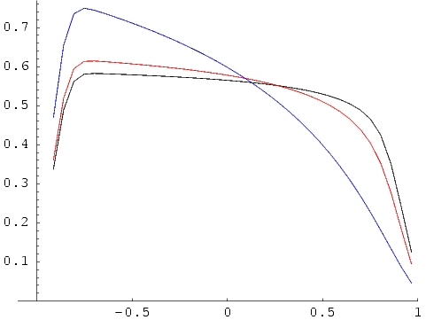
τ = 1 contours
τ∗=1,2,8
R_{o}=1.5
key parameters: R_{o} & τ*
j ~ ρ² for r/R* > R_{o}
= 0 otherwise
R_{o}=3
R_{o}=10
Notes:
25

Slide 26
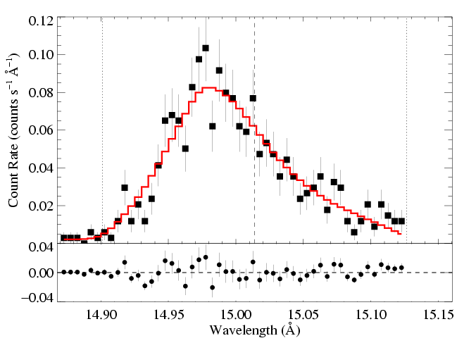
We fit these x-ray line profile models to each line in the Chandra data
Fe XVII
Fe XVII
Notes:
26

Slide 27
And find a best-fit τ* and R_{o}…
Fe XVII
τ* = 2.0
R_{o} = 1.5
Fe XVII
Notes:
27

Slide 28
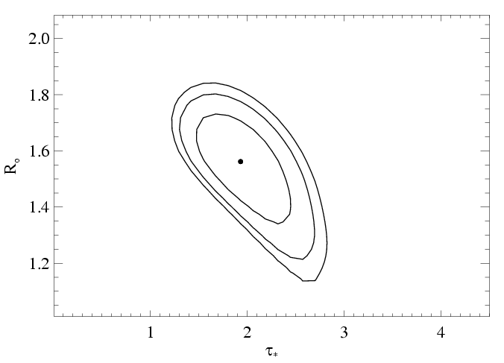
…and place confidence limits on these fitted parameter values
68, 90, 95% confidence limits
Notes:
28

Slide 29
Let’s focus on the R_{o} parameter first
Note that for β = 1,
v = 1/3 v_{inf} at 1.5 R*
v = 1/2 v_{inf} at 2 R*

Slide 30
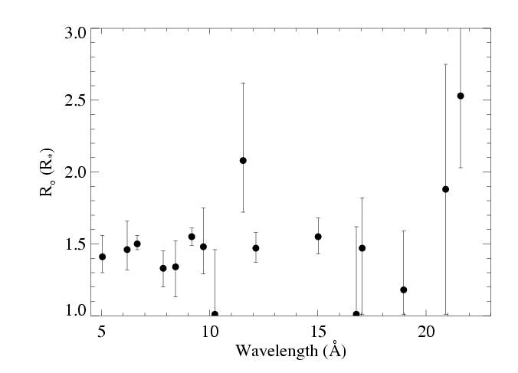
Distribution of R_{o} values in the Chandra spectrum of ζ Pup
Consistent with a global R_{o} = 1.5 R*

Slide 31
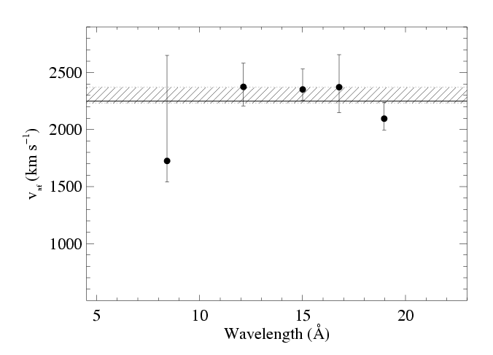
V_{inf} can be constrained by the line fitting too
V_{inf} from UV (2250 km/s)
68% conf. range for fit to these five points

Slide 32
Kinematics conclusions
Line widths and shapes are consistent with :
  X-ray onset radius of ~ 1.5 R*
  Same β, v_{inf} as the bulk, cold wind

Slide 33
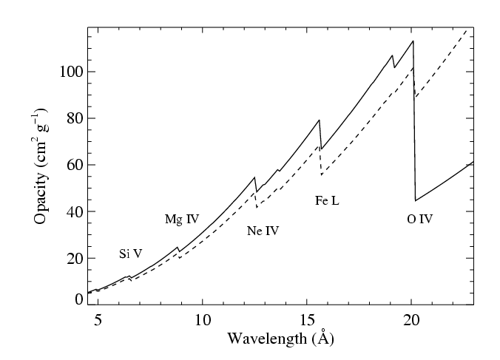
Wind Absorption
Next, we see how absorption in the bulk, cool, partially ionized wind component affects the observed X-rays
CNO processed
opacity
Solar

Slide 34
opacity of the cold wind
wind mass-loss rate
τ* is the key parameter describing the absorption
wind terminal velocity
radius of the star
Notes:
34

Slide 35
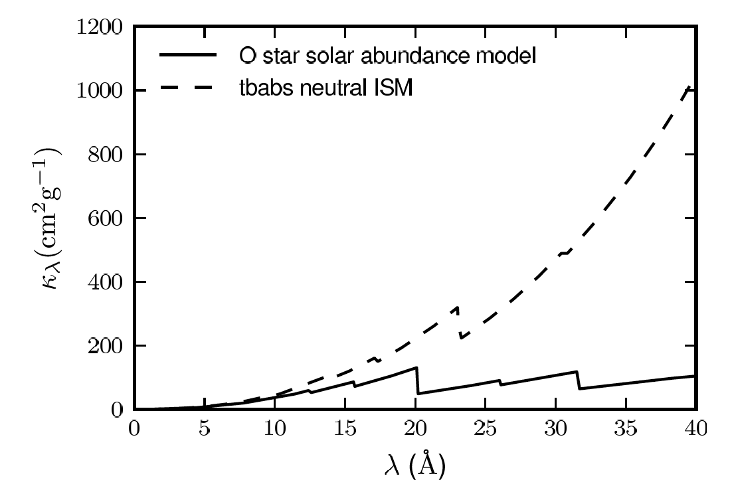
Wind opacity
X-ray bandpass
ISM
wind

Slide 36
Wind opacity
X-ray bandpass
Chandra HETGS

Slide 37
X-ray opacity
Zoom in
appropriate to ζ Pup
CNO processed
Opacity is bound-free,
inner-shell photoionization
Major ionization edges are labeled
Solar

Slide 38
This is the same Fe XVII line we saw a minute ago
Fe XVII
τ* = 2.0
R_{o} = 1.5
Fe XVII
Notes:
38

Slide 39
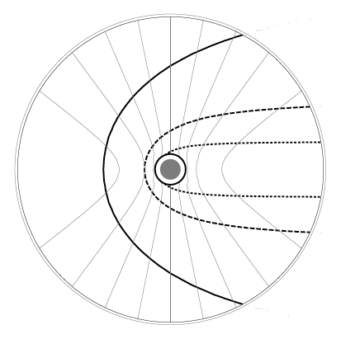
τ* = 2 in this wind
-0.2v_{inf}
+0.2v_{inf}
-0.6v_{inf}
+0.6v_{inf}
-0.8v_{inf}
+0.8v_{inf}
observer
on left
τ = 3
τ = 1
optical depth contours
τ = 0.3

Slide 40
Other lines?
Different κ – and thus τ* – at each wavelength

Slide 41
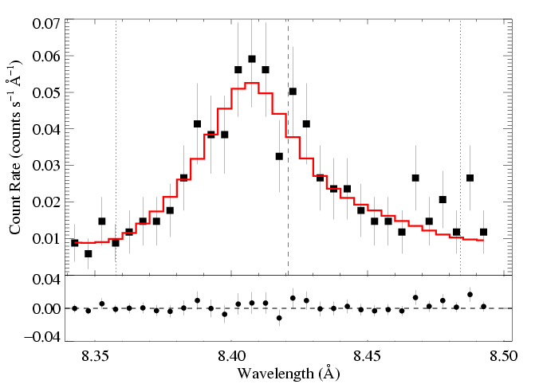
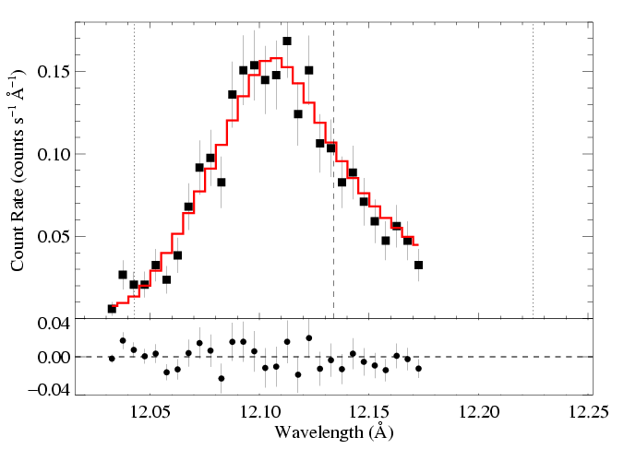
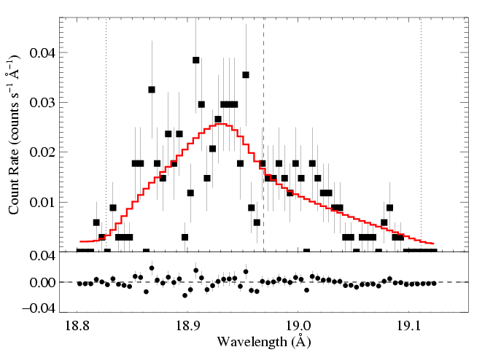
ζ Pup: three emission lines
Mg Lyα: 8.42 Å
Ne Lyα: 12.13 Å
O Lyα: 18.97 Å
τ* = 1
τ* = 2
τ* = 3
Recall:
Notes:
41

Slide 42
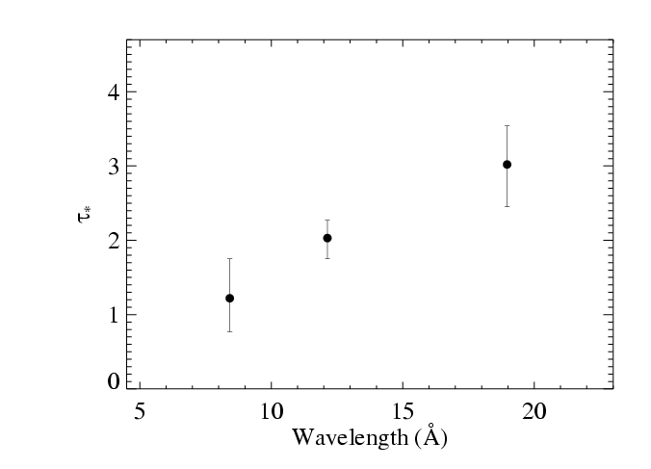
Results from the 3 line fits shown previously
Notes:
42

Slide 43
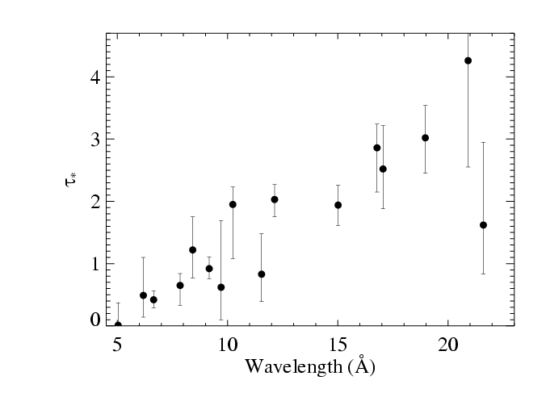
Fits to 16 lines in the Chandra spectrum of ζ Pup
Notes:
43

Slide 44
Fits to 16 lines in the Chandra spectrum of ζ Pup
Notes:
44

Slide 45
Fits to 16 lines in the Chandra spectrum of ζ Pup
τ*(λ) trend consistent with κ(λ)
Notes:
45

Slide 46
Fits to 16 lines in the Chandra spectrum of ζ Pup
CNO processed
τ*(λ) trend consistent with κ(λ)
Solar
Notes:
46

Slide 47
M becomes the free parameter of the fit to the τ*(λ) trend
τ*(λ) trend consistent with κ(λ)
Notes:
47

Slide 48
M becomes the free parameter of the fit to the τ*(λ) trend
τ*(λ) trend consistent with κ(λ)
Notes:
48

Slide 49
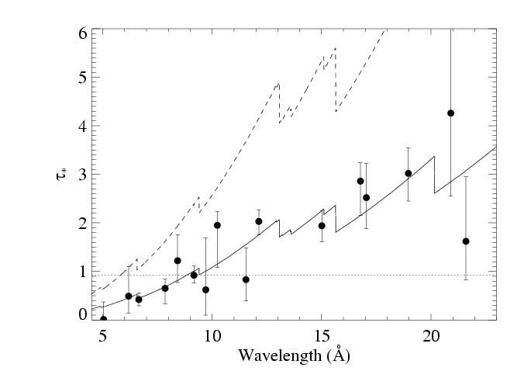
Traditional mass-loss rate:
8.3 X 10⁻⁶ M_{sun}/yr
From H_{α} ignoring clumping
Our best fit:
3.5 X 10⁻⁶ M_{sun}/yr
Notes:
49

Slide 50
Traditional mass-loss rate:
8.3 X 10⁻⁶ M_{sun}/yr
Fe XVII
Our best fit:
3.5 X 10⁻⁶ M_{sun}/yr
Notes:
50

Slide 51
Mass-loss rate conclusions
The trend of τ* value with λ is consistent with :
  Mass-loss rate of 3.5 X 10⁻⁶ M_{sun}/yr
  Factor of ~3 reduction w.r.t. unclumped H-alpha
Note: this mass-loss rate diagnostic is a column density diagnostic; it is not a density squared diagnostic and so is not sensitive to clumping (as long as individual clumps are not optically thick).

Slide 52
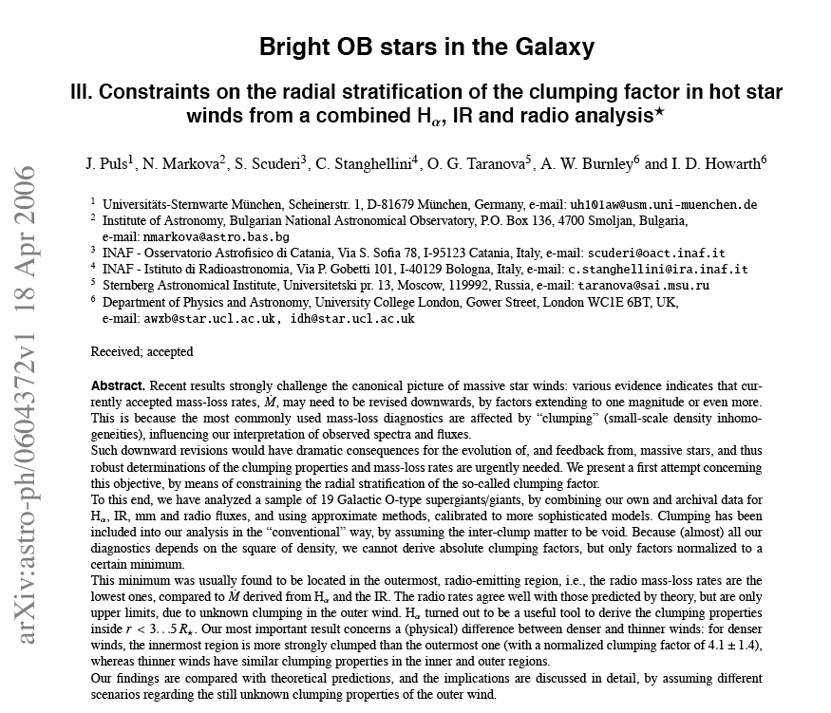
ζ Pup mass-loss rate < 4.2 x 10⁻⁶ M_{sun}/yr
Notes:
52

Slide 53
Implications for broadband X-rays

Slide 54
Si XIV
Mg XII
Ne X
H-like vs. He-like
Si XIII
Mg XI
Ne IX
ζ Pup (O4 If)
Capella (G5 III) – coronal source
– for comparison

Slide 55
Mg XII
H-like vs. He-like
Mg XI
ζ Pup (O4 If)
Capella (G5 III) – coronal source
– for comparison
Notes:
Capella, the coronal source, has hotter plasma (larger H/He ratios)…but note, overall, the O star, zeta Pup’s spectrum is harder

Slide 56
Mg XII
H-like vs. He-like
Mg XI
ζ Pup (O4 If)
Capella (G5 III) – coronal source
– for comparison
Notes:
Capella, the coronal source, has hotter plasma (larger H/He ratios)…but note, overall, the O star, zeta Pup’s spectrum is harder

Slide 57
Spectral energy distribution trends
The O star has a harder spectrum, but apparently cooler plasma
This is explained by wind absorption

Slide 58
Wind absorption model
Note that a realistic model of the radiation transport and of the opacity is required to properly account for broadband absorption effects
See Leutenegger et al. 2010 for simple method to incorporate these effects into data analysis

Slide 59
Other stars?

Slide 60
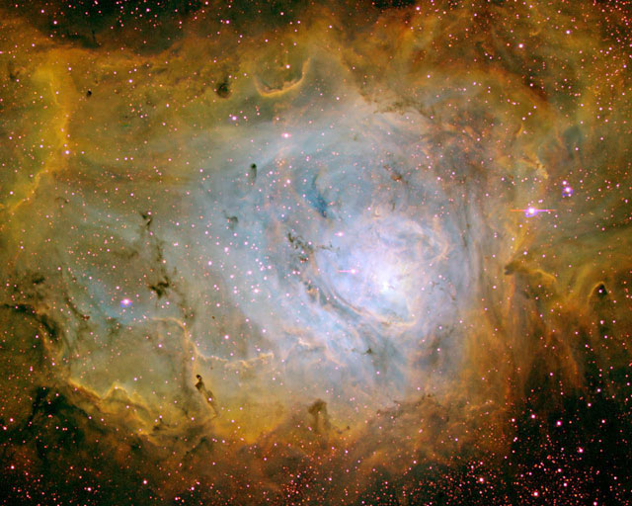
9 Sgr (O4 V)
Lagoon Nebula/M8: Barba, Morrell

Slide 61
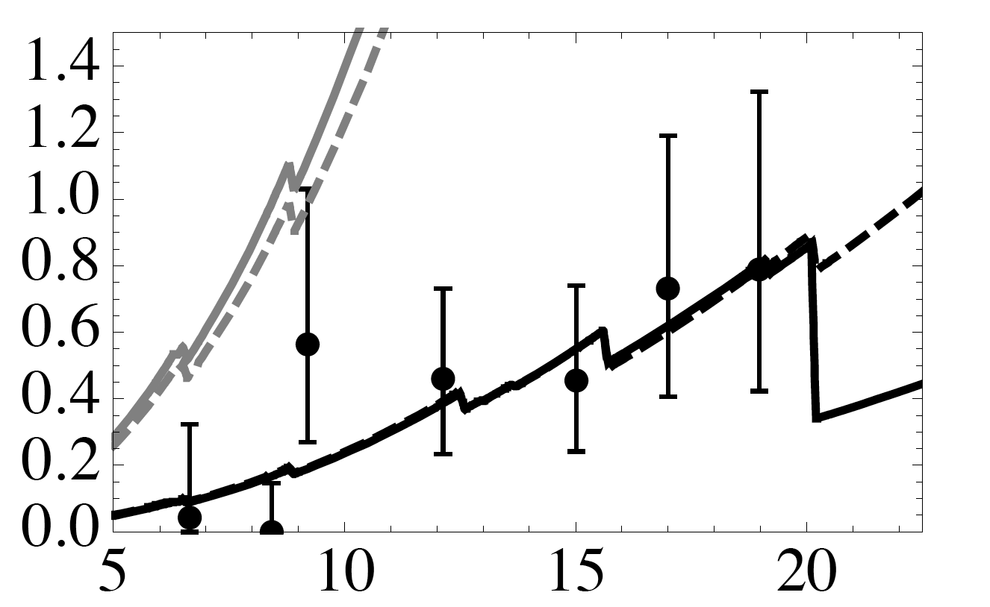
9 Sgr (O4 V): τ* values
M reduction: factor of 6
2.4 X 10⁻⁶ to 4 X 10⁻⁷
τ*
wavelength

Slide 62
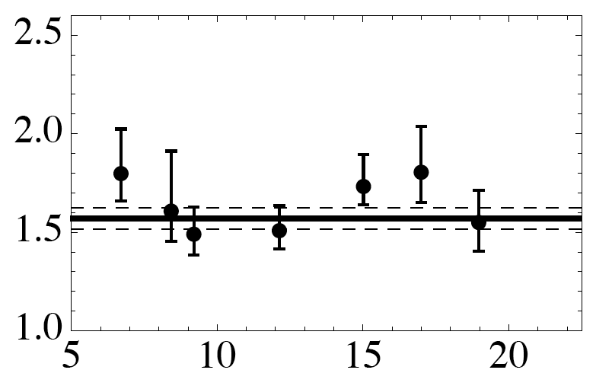
9 Sgr (O4 V): R_{o} values
R_{o} = 1.6 R*
R_{o}
wavelength

Slide 63
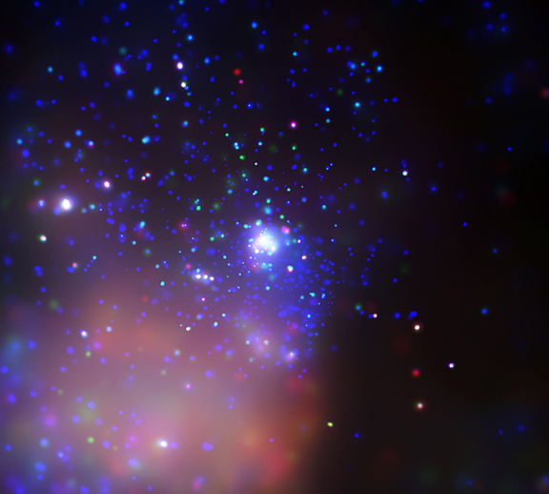
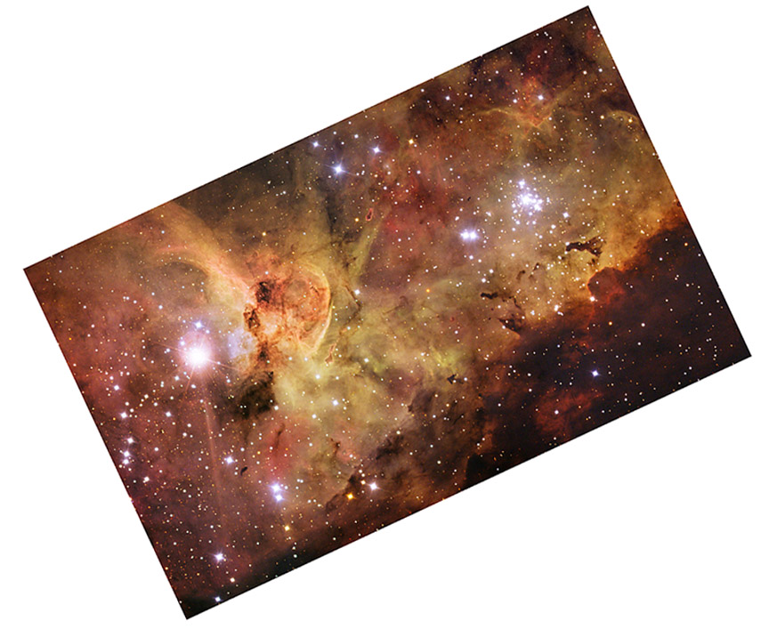
HD 93129A (O2If*) is the 2nd brightest X-ray source in Tr 14
Tr 14: Chandra
Carina: ESO

Slide 64
HD93129A – O2 If*
Extremely massive (120 M_{sun}), luminous O star (10^{6.1} L_{sun})
Strongest wind of any Galactic O star
(2 X 10⁻⁵ M_{sun}/yr; v_{inf} = 3200 km/s)
From H-alpha, assuming a smooth wind

Slide 65
There is an O3.5 companion with a separation of ~100 AU
But the vast majority of the X-rays come from embedded wind shocks in the O2If* primary

Slide 66
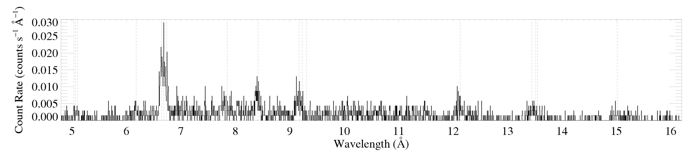
Its X-ray spectrum is hard
Si XIV
Si XIII
Mg XII
Mg XI
H-like vs. He-like

Slide 67
Its X-ray spectrum is hard
Si
Mg
low H/He
But the plasma temperature is low:
little plasma with kT > 8 million K

Slide 68
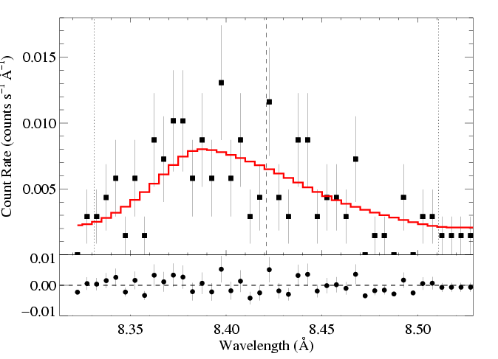
M-dot ~ 2 x 10⁻⁵ M_{sun}/yr from unclumped Hα
HD 93129A (O2 If*): Mg XII Lyα 8.42 Å
V_{inf} ~ 3200 km/s
R_{o} = 1.8 R*
τ* = 1.4
M-dot ~ 5 x 10⁻⁶ M_{sun}/yr
Notes:
68

Slide 69
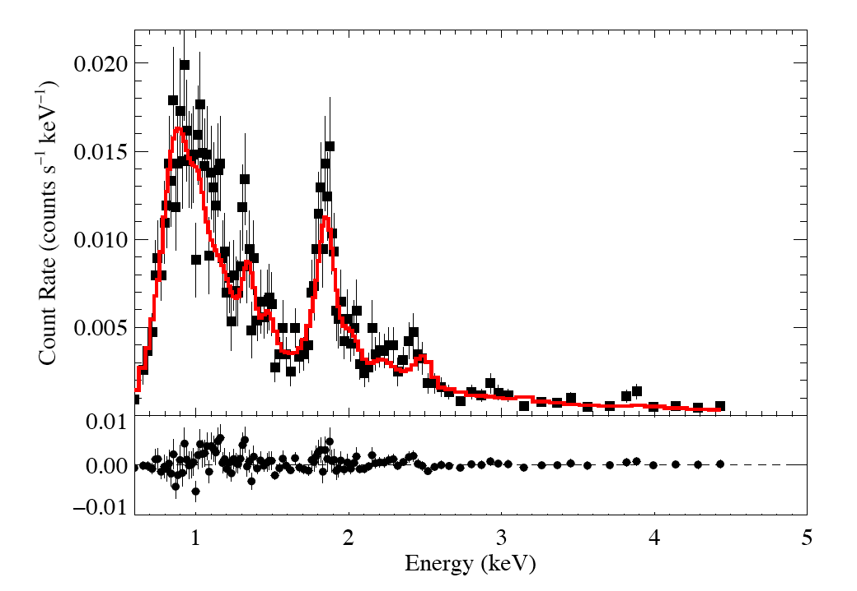
Low-resolution Chandra CCD spectrum of HD93129A
Fit: thermal emission with wind + ISM absorption plus a second thermal component with just ISM
kT = 0.6 keV *wind_abs*ism
add 5% kT = 2.0 keV*ism

Slide 70
consistent with result from line profile fitting
τ*/κ = 0.03 (corresp. ~ 5 x 10⁻⁶ M_{sun}/yr)
Typical of O stars like ζ Pup
kT = 0.6 keV *wind_abs*ism
add 5% kT = 2.0 keV*ism
small contribution from colliding wind shocks

Slide 71
Approximations and assumptions
Extensively discussed in Cohen et al. 2010
Biggest factors:
β
V_{inf}
opacity (due to unc. in metallicity)

Slide 72
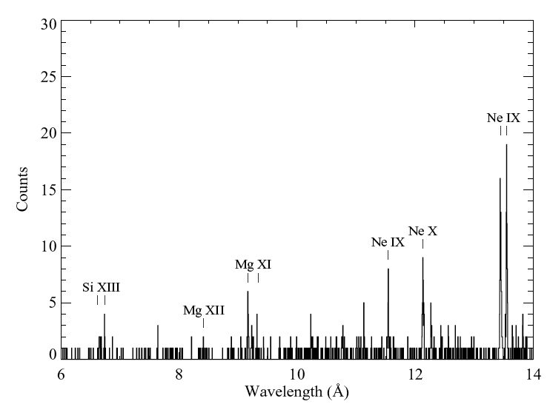
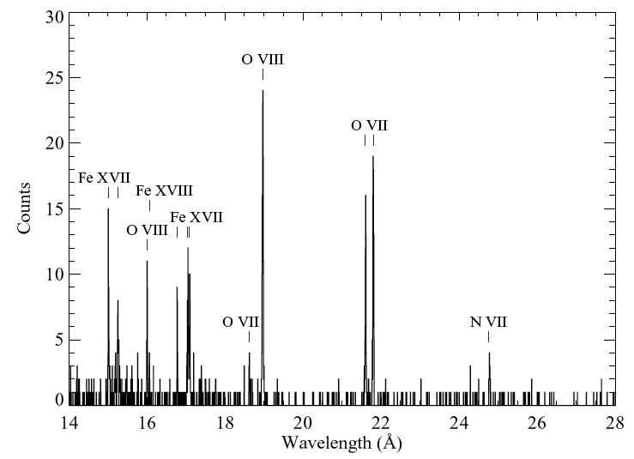
Early B (V – III) stars with weak winds
X-ray flux levels in many B star are high considering their low mass-loss rates (known since ROSAT in the 1990s)
Chandra spectroscopy of β Cru (B 0.5 III)

Slide 73
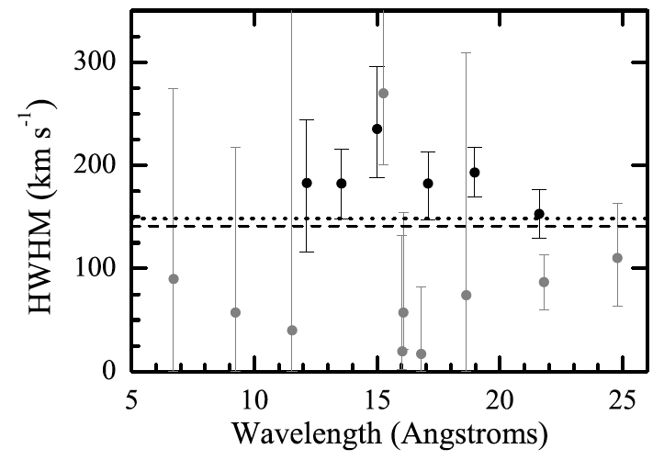
X-ray lines are narrow
HWHM ~ 150 km/s on average

Slide 74
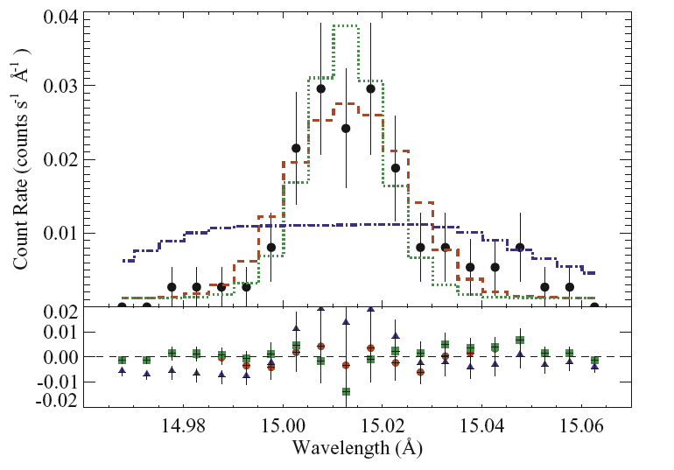
Much narrower than expected…
From the bulk CAK wind
expectation from
CAK wind

Slide 75
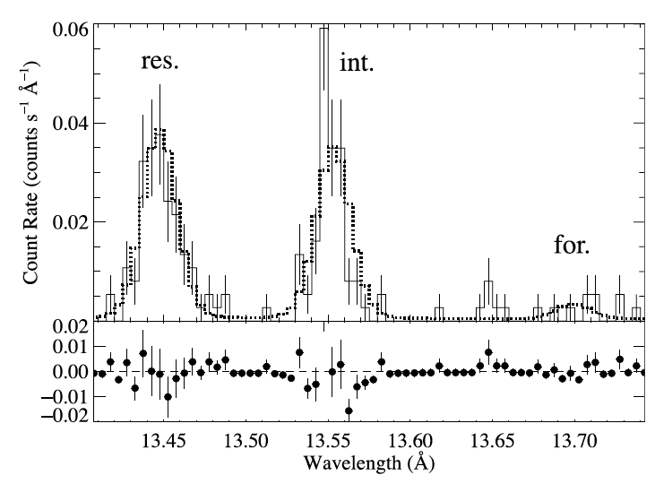
Hot plasma is located in the wind
He-like ions’ forbidden-to-intercombination line ratios indicate location

Slide 76
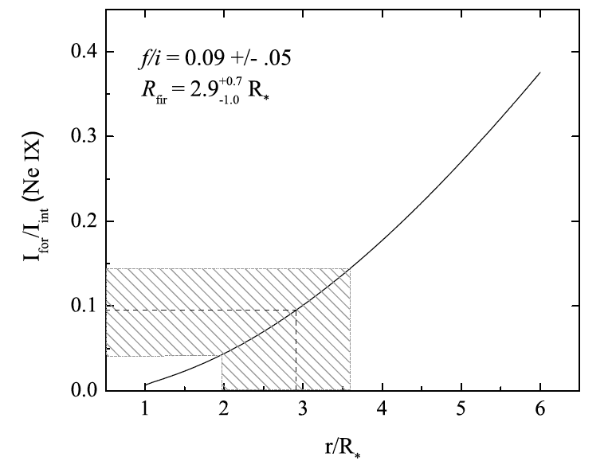
At least 1 R* above the photosphere

Slide 77
B star X-rays are very hard to explain
Lines are not broad
But X-ray plasma is well out in the wind flow
X-ray emission measure requires a substantial fraction of the wind to be hot (> 10⁶ K)

Slide 78
Conclusions
Single O stars – like ζ Pup – X-ray line shapes are consistent with kinematics from shock models
And profiles can be used as a clumping-independent mass-loss rate diagnostics
Results are consistent with factor of 3 to 6 reduction over Hα determinations that assume a smooth wind

Slide 79
Conclusions, pt. 2
Broadband wind absorption is measurable
It can significantly harden the observed spectra
And it, too, is consistent with factor of 3 to 6 reduction over Hα determinations that assume a smooth wind
Even extreme O star winds like HD 93129A’s are consistent with these results
It’s the early B star winds that are hard to understand

Slide 81
Extra Slides

Slide 83
Caveats, reflections
Why did it take so long to identify the wavelength trend?
Realistic opacity model
Resonance scattering
Porosity and clumping

Slide 84
Which lines are analyzed?
There are 21 complexes in the Chandra spectrum; we had to exclude 5 due to blending
The short wavelength lines have low S/N, but are very important – leverage on wavelength-dependence of opacity

Slide 85
Seven short wavelength lines never before analyzed

Slide 86

Simplified opacity models are too steep
Oskinova, Feldmeier,Hamann 2006

Slide 87
Detailed opacity model is important
CNO processed
Realistic opacity is flatter between 12 and 18 Å
Solar

Slide 88


Resonance Scattering
A few lines may be subject to resonance scattering: Evidence in XMM spectrum for O VII:
no res. scatt.
with res. scatt.
Leutenegger et al., 2007

Slide 89
What about porosity?

Slide 90

“Clumping” – or micro-clumping: affects density-squared diagnostics; independent of clump size, just depends on clump density contrast (or filling factor, f )
visualization: R. Townsend

Slide 91
But porosity is associated with optically thick clumps, it acts to reduce the effective opacity of the wind; it does depend on the size scale of the clumps
Note: whether clumps meet this criterion depends both on the clump properties and on the atomic process/cross-section under consideration
The key parameter is the porosity length,
h = (L³/ℓ²) = ℓ/f
ℓ
L
f = ℓ³/L³

Slide 92
Clump size increasing →
The porosity length, h:
clump size
h = ℓ/f
Porosity length increasing →
clump filling factor (<1)

Slide 93
Clump size increasing →
No Porosity
Porosity length increasing →
Porous wind

Slide 94

Porosity only affects line profiles if the porosity length (h) exceeds the stellar radius

Slide 95
The clumping in 2-D simulations (density shown below) is on quite small scales
Dessart & Owocki 2003, A&A, 406, L1
Notes:
95

Slide 96
No expectation of porosity from simulations
Natural explanation of line profiles without invoking porosity
Finally, to have porosity, you need clumping in the first place, and once you have clumping…you have your factor ~3 reduction in the mass-loss rate
Notes:
96

Slide 97
No expectation of porosity from simulations
Natural explanation of line profiles without invoking porosity
Finally, to have porosity, you need clumping in the first place, and once you have clumping…you have your factor ~3 reduction in the mass-loss rate
Notes:
97

Slide 98
No expectation of porosity from simulations
Natural explanation of line profiles without invoking porosity
Finally, to have porosity, you need clumping in the first place, and once you have clumping…you have your factor ~3 reduction in the mass-loss rate
(for ζ Pup, anyway)
Notes:
98

Slide 99
f ~ 0.1 is indicated by Hα, UV, radio free-free analysis
f = 0.2
f = 0.05
f = 0.1

Slide 100
And lack of evidence for porosity…
leads us to suggest visualization in upper left is closest to reality
f = 0.2
f = 0.05
f = 0.1

Slide 101
Though simulations suggest even smaller-scale clumping
f = 0.2
f = 0.05
f = 0.1

Slide 102

Incidentally, you can fit the Chandra line profiles with a porous model
But, the fit isn’t as good and it requires a porosity length of 3 R*!

